Slide 1
Advanced AI for Business Applications
Andy Jeon, Ph.D.
Matt Pickard, Ph.D.
College of Business
Northern Illinois University

Slide 2

Andy Jeon, Ph.D.

Slide 3
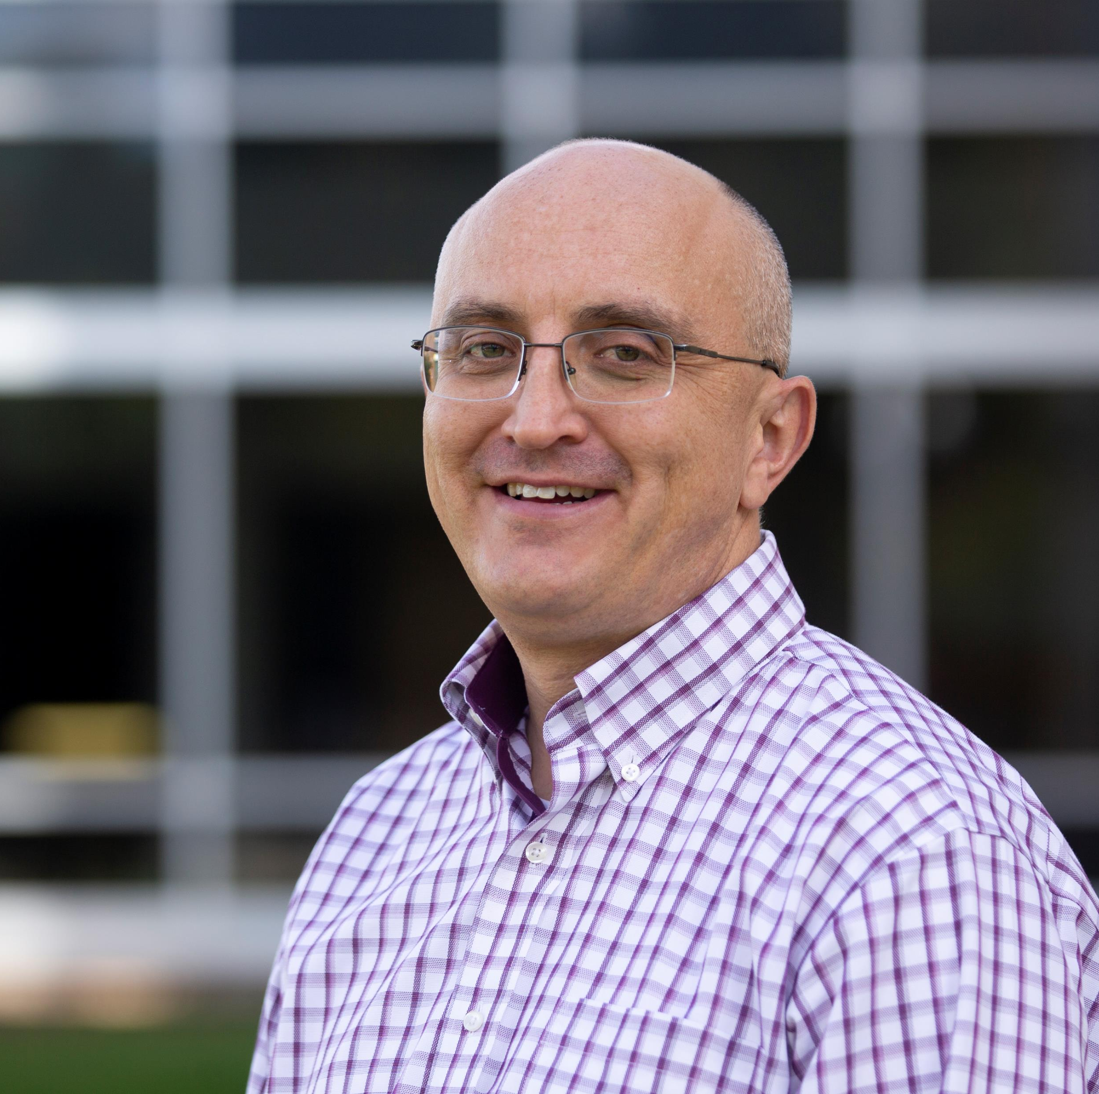
Matt Pickard, Ph.D.
Associate Professor of Data and Analytics @ NIU
Brigham Young University
2002 BS Computer Engineering
2008 MBA
University of Arizona
2012 PhD MIS
Married, father of four girls, loves nature, woodworking, and reading.

Slide 4
Some Questions
Are you currently working on a project involving AI or machine learning?
What tools do you use to implement AI solutions?
Have you created solutions in Scikit-learn, Tensorflow, or a similar framework (e.g., PyTorch, Keras)?
How extensively and often do you code in Python?

Slide 5

Agenda
AI Taxonomy—Overview of AI Models and Tasks
Model Creation and Validation Process
Deep Learning
Generative AI

Slide 6
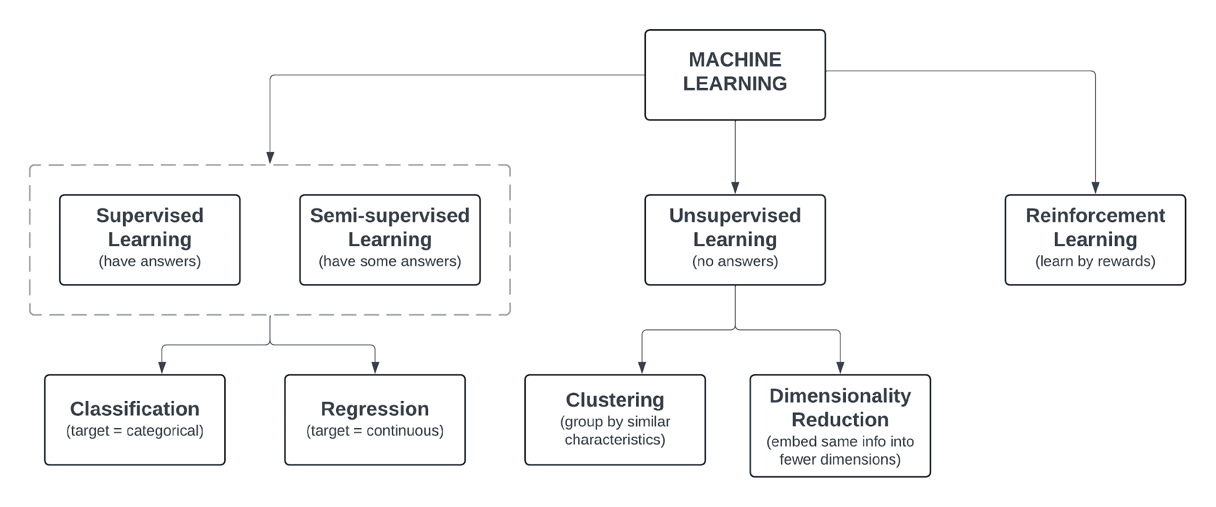
ML Algorithms by Learning Style
Put link to taxonomy document here.

Slide 7
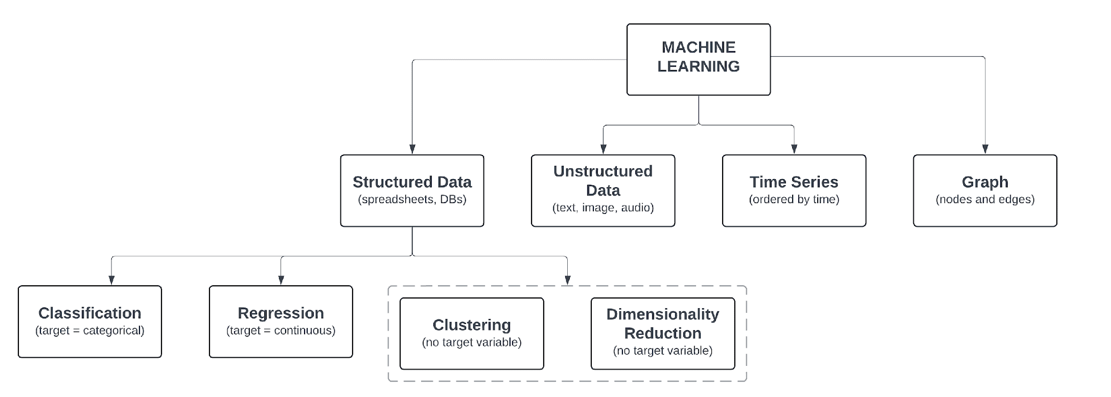
ML Algorithms by Type of Data
Put link to taxonomy document here.

Slide 8
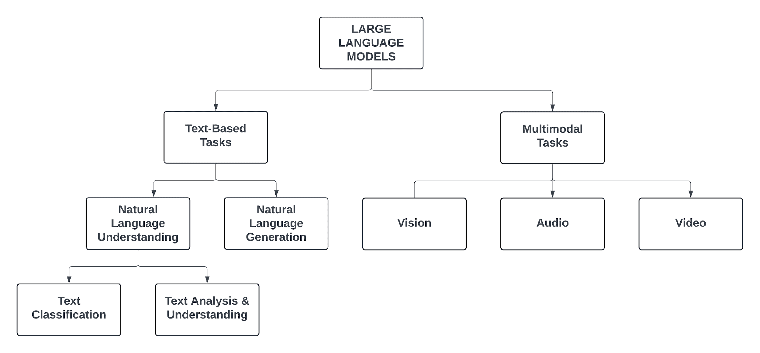
Large Language Model (LLM) Taxonomy
Put link to taxonomy document here.

Slide 9
Model Building Process
Collect Data
Evaluate
Split Data
Validate
Prepare Date
Train

Slide 10

Collect the Data
SOURCE: Images generated by Google Gemini.

Slide 11
Things to Consider
Data quality: accurate, relevant, complete
Representative: ensure the data is representative of all scenarios in your real-world problem
Balance: ideally have a balanced distribution of all values and classes
Quantity: training a ML algorithm requires a lot of data, plus need extra for validation and evaluation

Slide 12

Split the Data
SOURCE: Images generated by Google Gemini.

Slide 13
Split the Data: Basic Splits
All Data
Training
Validation
Test
Teach the model
Evaluate while training
Prevent overfitting
Tune hyperparameters
Final evaluation of the model performance

Slide 14
Split the Data: k-Fold Cross Validation
Fold 1
Training
V
Accuracy 1
Important! The test set must be new and unseen by the model
Fold 2
Accuracy 2
Test
Fold 3
Accuracy 3
Avg
Accuracy
Final
Accuracy
Evaluation
Fold 4
Accuracy 4
...
Fold k
Accuracy k

Slide 15
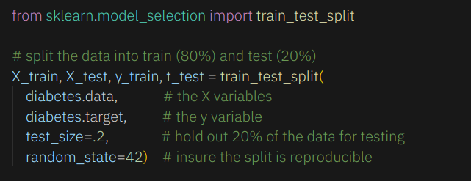
Train-Test Split with scikit-learn

Slide 16
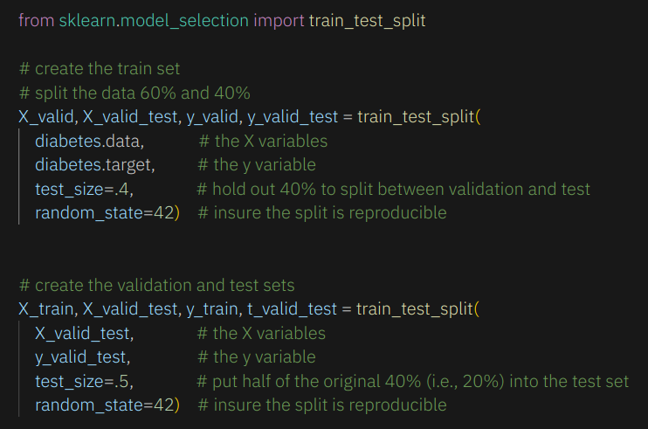
Train-Validation-Test Split with scikit-learn

Slide 17
k-Fold Validation with scikit-learn

Slide 18

Split Data Example Code
You can find a Python notebook with examples of splitting data in the SplitData.ipynb.

Slide 19

Prepare the Data
Data preparation typically constitutes 80% of the work involved in modeling.
SOURCE: Images generated by Google Gemini.

Slide 20
Typical Data Preparation Tasks
Basically, data preparation is performing anything necessary to clean, enrich, and make the data compatible with the algorithm.
Imputing missing values
Feature extraction (e.g., from text)
Feature engineering
Scaling variables
Encoding categorical variables (dummy coding)
Dimensionality reduction
Pivoting / transforming the shape of the data

Slide 21
Data Preparation and Pipelines
Pipeline
Imputation
Scaling
Feature Engineering
Model
Data
Predictions
Here's the scikit-learn pipeline documentation.

Slide 22
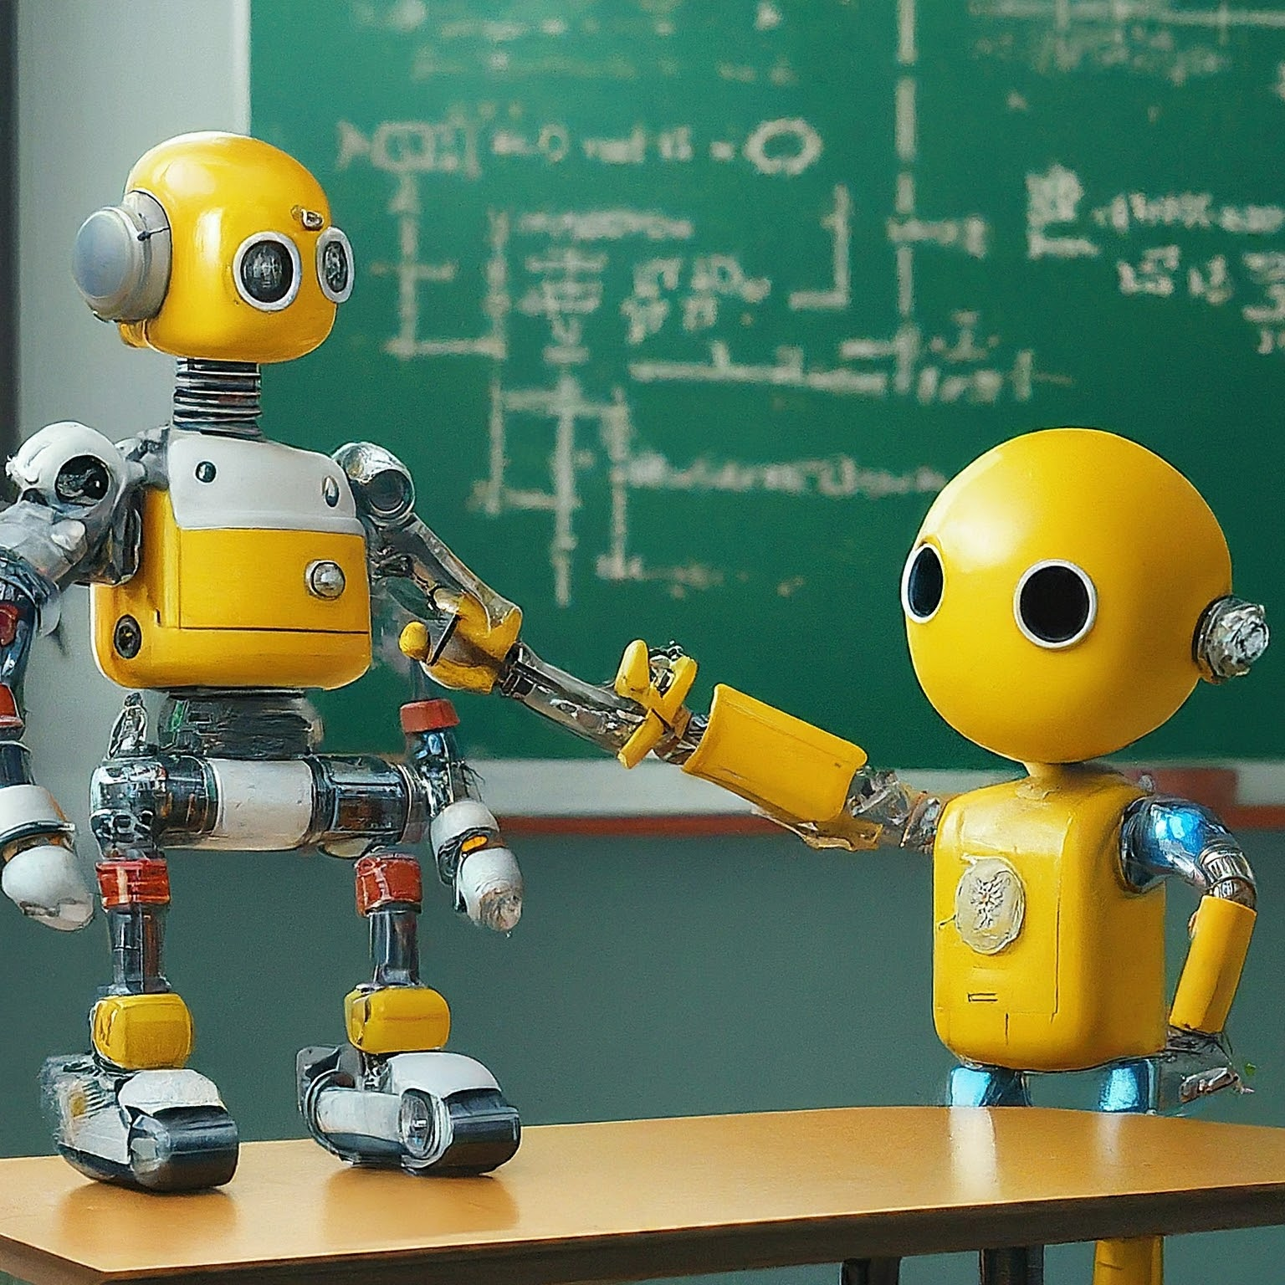
Train the Model
SOURCE: Image generated by Google Gemini.

Slide 23
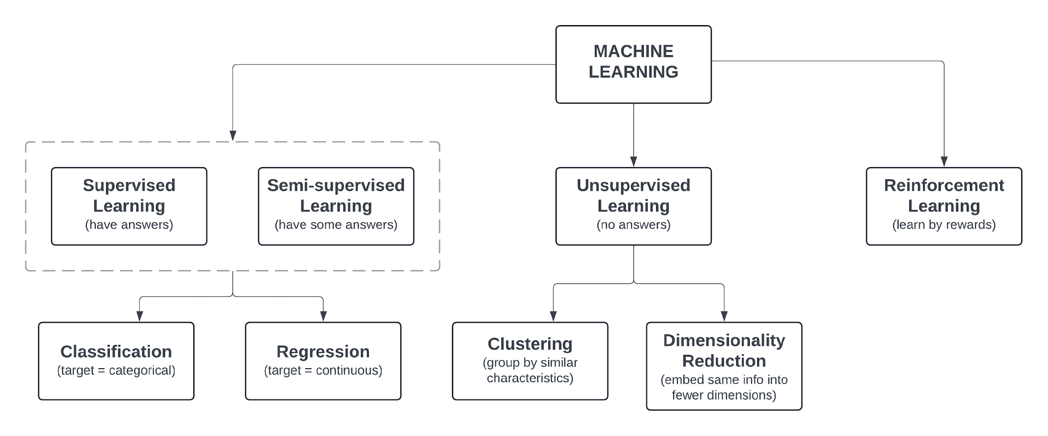
First, Select the Model(s)

Slide 24

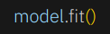
Train the Model
Goal: minimize error between predictions and actual target values
Two basic steps in scikit-learn:
Create the model object
Fit the data to the model
SOURCE: Image generated by Google Gemini.

Slide 25
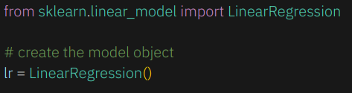
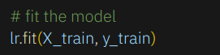
Train the Model (in scikit-learn)
Create a linear regression model object
Fit the model

Slide 26
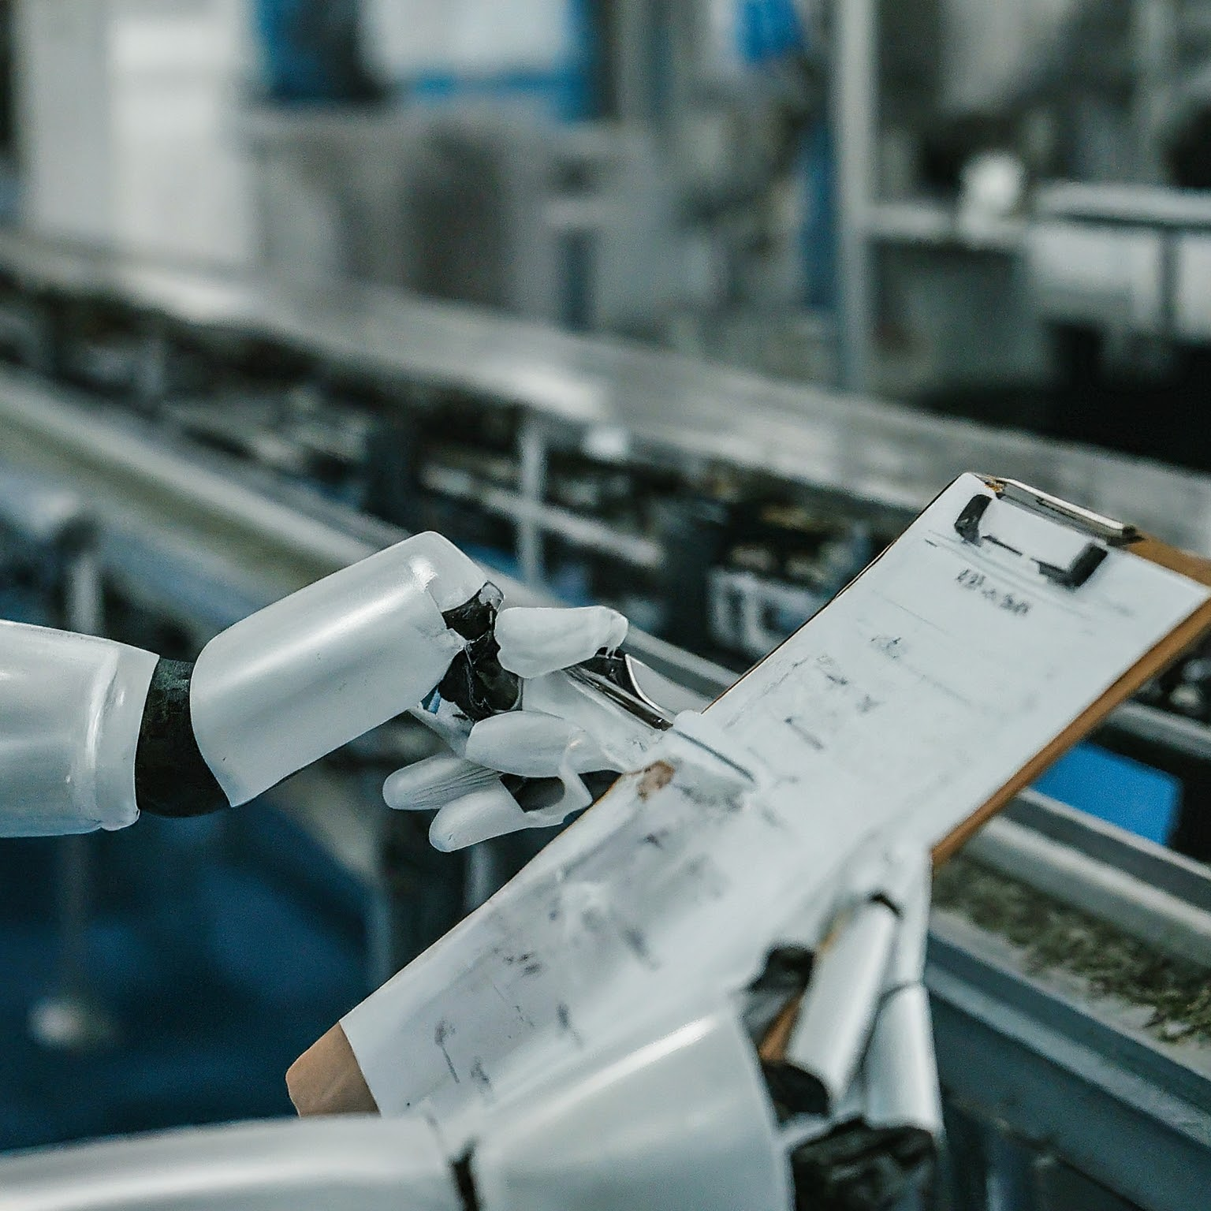
Validate the Model
SOURCE: Images generated by Google Gemini.

Slide 27
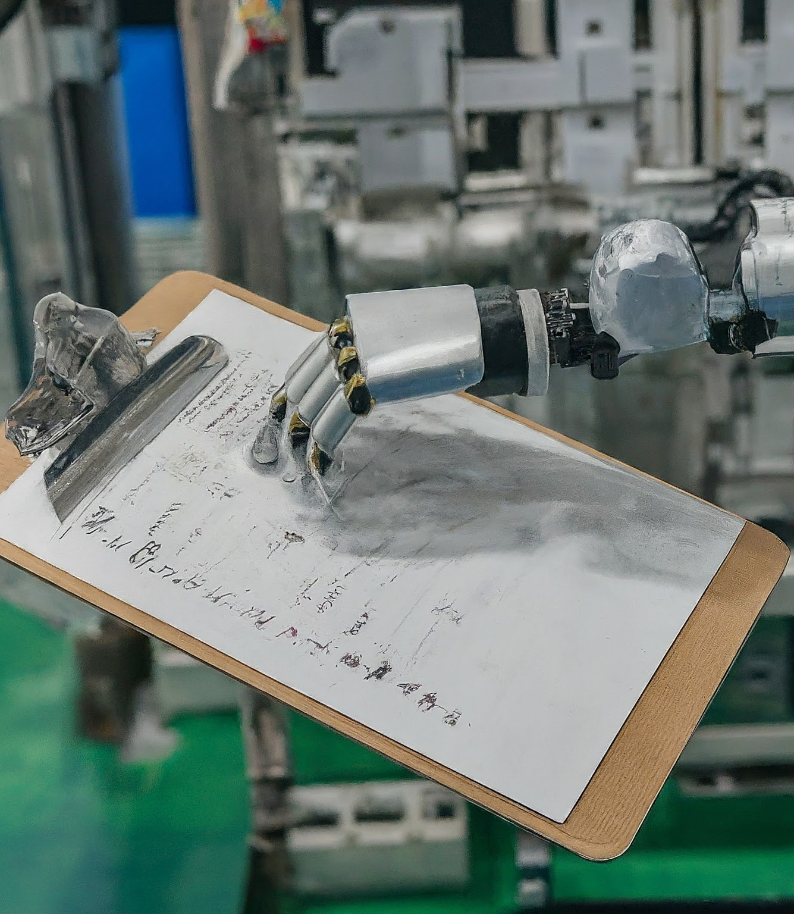
Validation has the following general objectives:
Prevent overfitting
Verify the model's soundness
Detect biases
Detect data leakage
Tune hyperparameters (e.g., learning rate)
SOURCE: Images generated by Google Gemini.

Slide 28
Hyperparameters
External configuration variables that are not adjusted during training which affect the learning process of the model algorithm.
Deep Learning Examples
Random Forest Examples
Learning rate
Learning rate decay
Batch size
# of epochs (training cycles)
Regularization
Number of trees
Max tree depth
Number of features
Split criterion
# of processes to use

Slide 29

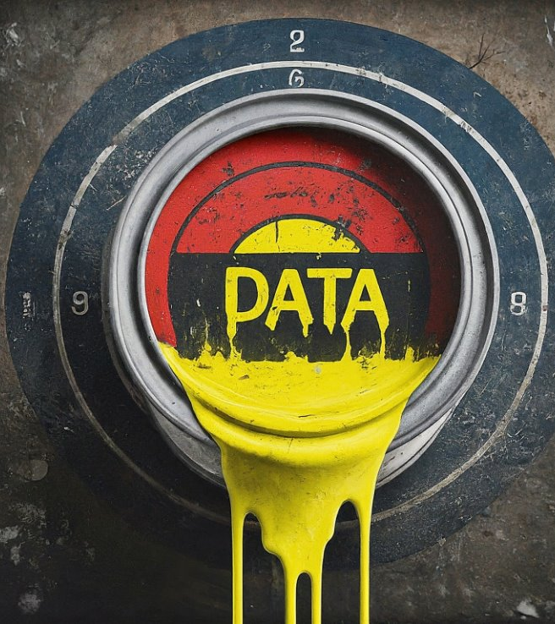
Avoid Data Leakage
SOURCE: Images generated by Google Gemini.

Slide 30
Data Leakage
EXAMPLES
Using a "fraud flag" to predict a fraudulent transaction (transactions are not "flagged" until after they occur and are investigated)
Using a "cancelation date" to predict customer churn
Using filenames (e.g., "cat1.jpg" or "dog3.jpg") to predict the presence of an animal in the image
Occurs when the data with which you are training the model contains information about what you are trying to predict

Slide 31
Data Leakage: Consequences
Poor Generalization to New Data
Validation performance is falsely optimistic, performance on new data is poor.
Unreliable Predictions
This results in misguided and potential costly, poor decisions.
Delayed Detection of Poor Model Performance
Easy to "believe" you have a good model based on good validation and test results, but meanwhile your model is performing poorly in a real-world production environment.

Slide 32
Data Leakage: Common Causes & Solutions
 | Problem | Example | Solution
Target Leakage (Leaking Predictors) | Including training data that won't be available at the time of prediction. | Using a cancelation date to predict customer churn. | Do not use variables for training that will not be available at the time of prediction.
Train-Test Contamination | Information from the test or validation set indirectly influences the model during training. | Scaling variables using the entire dataset before splitting out the train and test sets. (Scaling factors contain information from test set.) | Split out a test set that remains separate until the model is trained and ready for evaluation.

Slide 33
Data Leakage: Common Causes & Solutions
 | Problem | Example | Solution
Time-Dependent Leakage (Time-series specific) | Using future time-series data to predict past events. | Randomly shuffling stock price data by date, then splitting into train and test. (Not all test samples occur before the train samples.) | Ensure that all data in the validation or test sets occurs after data in the train set.
Feature Engineering Bias | Engineering features with variables that are highly correlated with the target variable. | Generating profit from revenue and cost variables, then using revenue and cost to predict profit. | Ensure that predictor variables are not highly correlated with the target variable.

Slide 34

Evaluate the Model
The primary goal of evaluating a model is to assess its performance and ability to generalize to unseen data.
SOURCE: Image generated by Google Gemini.

Slide 35

What is Performance?
Accuracy (lack of error)
Speed
Scalability
Interpretability
Fairness (lack of bias)
We'll focus on accuracy.
SOURCE: Images generated by Google Gemini.

Slide 36
Evaluation of Regression Models

Slide 37
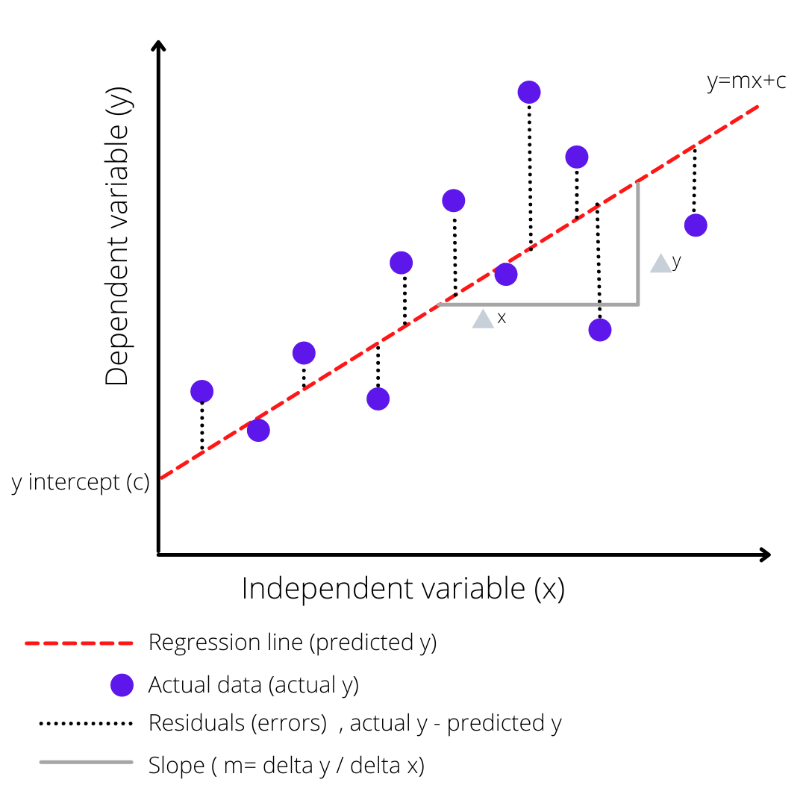
What is Error in Regression?
Error
Also called “residuals”
Three main error calculations:
Mean Squared Error (MSE)
Root Mean Squared Error (RMSE)
Mean Absolute Error (MAE)
SOURCE: https://miro.medium.com/v2/format:webp/0*ni7b6FKU2OTTAtyL.png

Slide 38
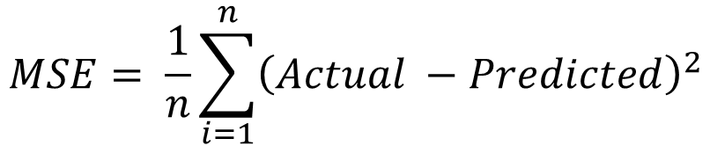
Regression Error Metrics: Mean Squared Error
Penalizes larger errors more
More sensitive to outliers
Squared units are difficult to interpret
Inventory Forecasting
Small inventory forecasting errors are generally acceptable, but large over- or under-predictions can lead to expensive inventory excesses or shortages issues. MSE penalizes large errors, but it’s difficult to interpret.

Slide 39
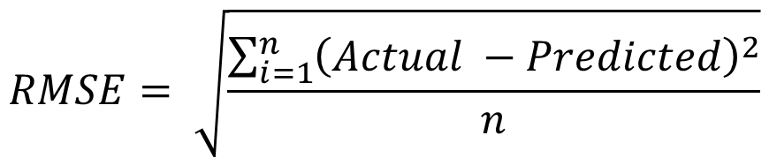
Regression Error Metrics: Root Mean Squared Error
Penalizes larger errors more
More sensitive to outliers
Easier to interpret—same units as original data
Inventory Forecasting
Small inventory forecasting errors are generally acceptable, but large over- or under-predictions can lead to expensive inventory excesses or shortages issues. RMSE penalizes large errors, plus it’s easy to interpret as “average inventory deviation”.

Slide 40
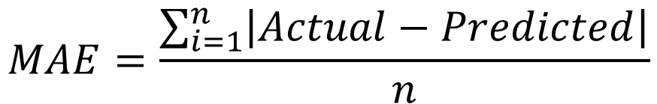
Regression Error Metrics: Mean Absolute Error
Robust to Outliers
Easy to interpret—same units as original data
Predicting House Prices
When predicting housing prices, MAE is often favored. A MAE of $10,000 means, on average, your predictions are off by $10,000. This is easy for clients to understand. Also, expensive mansions don’t skew MAE as much as they would with MSE/RMSE.

Slide 41
Regression Error Metric Guidelines
Situation | Metric to Use
Outliers are a major concern | MAE
Want to penalize larger errors | MSE or RMSE
Need ease of interpretation (same unit as data) | RMSE or MAE
These metrics are most useful in relation to a reference value. For example, if you fit three different types of regression models, the “best” model would have the lowest MAE.

Slide 42
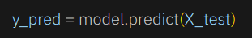
General Steps for Model Evaluation
Create predictions from the test set
Remember! You have the labels (i.e. “actual” values) in the test set.
Calculate the metrics using the actual and predicted values.
Frameworks like scikit-learn usually have predefined methods to calculate various metrics (like MSE). For example,

Slide 43
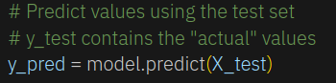
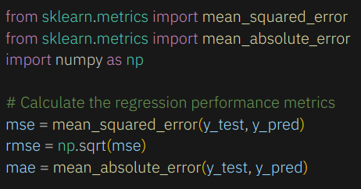
Regression Model Evaluation (in scikit-learn)
Use the regression model object to predict the test values.
Calculate the desired metrics.

Slide 44
Regression Example Code
TrainEvaluationModel – Regression.ipynb demonstrates the model building and evaluation process for a regression model

Slide 45
Evaluation of Classification Models

Slide 46
Confusion Matrix — Define error
Predicted
 | Positive | Negative
Positive | True Positive (TP) | Type II Error False Negative (FN)
Negative | Type I Error False Positive (FP) | True Negative (TN)
Actual

Slide 47
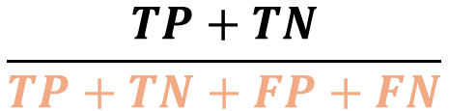
Accuracy
Predicted
Out of all the predictions, how many were correct?
 | Positive | Negative
Positive | True Positive (TP) | False Negative (FN)
Negative | False Positive (FP) | True Negative (TN)
“Success Rate”
Actual

Slide 48
Imbalanced Data and Base Rate - Fraud
Predicted
1 out of 100 (base rate = 1%) transactions are fraudulent
Predict all transactions are “valid” = 99 TP + 1 FN
That’s 99% accurate!
But ignores the cost of lost customers.
 | Fraud | Valid
1 Fraud | 0 (TP) $10k to fix | 1 (FN) $50k = lost customer
99 Valid | 0 (FP) $500 to investigate | 99 (TN) $0
Actual

Slide 49
Imbalanced Data and Base Rate - Terrorist
Predicted
1 out of 1,000,000
(base rate = 0.0001%)
Border crossings are terrorists
Predict all individuals are “terrorists” = 999,999 TP + 1 FN
That’s 99.9999% accurate!
What’s the cost of a terrorist attack?
 | Terrorist | Harmless
1 Terrorist | 0 (TP) | 1 (FN)
999,999 Harmless | 0 (FP) | 999,999 (TN)
Actual

Slide 50
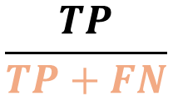
Sensitivity (Recall)
Predicted
Of all the actual positive cases, how many were correctly predicted as positive?
 | Positive | Negative
Positive | True Positive (TP) | False Negative (FN)
Negative | False Positive (FP) | True Negative (TN)
“True Positive Rate”
Actual

Slide 51
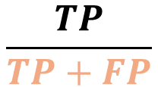
Precision
Predicted
Of all the positive predictions, how many were actually positive?
 | Positive | Negative
Positive | True Positive (TP) | False Negative (FN)
Negative | False Positive (FP) | True Negative (TN)
“Positive Predictive Value”
Actual

Slide 52
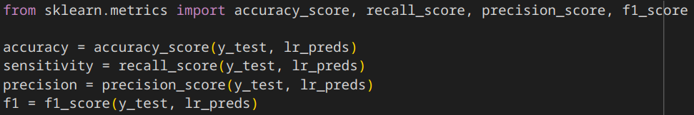
Calculate Metrics in scikit-learn

Slide 53
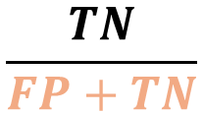
Specificity
Predicted
Of all the actual negative cases, how many were correctly predicted as negative?
 | Positive | Negative
Positive | True Positive (TP) | False Negative (FN)
Negative | False Positive (FP) | True Negative (TN)
“True Negative Rate”
Actual

Slide 54
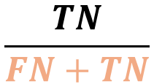
Negative Predictive Value (NPV)
Predicted
Of all the negative predictions, how many were actually negative?
 | Positive | Negative
Positive | True Positive (TP) | False Negative (FN)
Negative | False Positive (FP) | True Negative (TN)
Actual

Slide 55
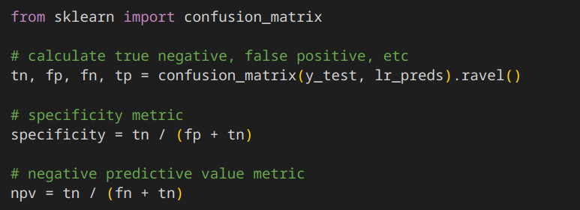
Calculate Other Metrics in scikit-learn

Slide 56
Terrorist Detection — The Easy Way
Predicted
Accuracy = 99.9999%
Sensitivity = 0 / 0+1 = 0%
Specificity = 999,999 / 999,999 = 100%
Precision = 0 / 0 + 0 = NaN
NPV = 999,999 / 1M = 99.9999%
 | 0 Terrorist | 1,000,000 Harmless
1 Terrorist | 0 (TP) | 1 (FN)
999,999 Harmless | 0 (FP) | 999,999 (TN)
Actual

Slide 57
Terrorist Detection — The Right Way
Predicted
Accuracy = 100%
Sensitivity = 1 / (0+1) = 100%
Specificity = 999,999 / 999,999 = 100%
Precision = 1 / (1 + 0) = 100%
NPV = 999,999 / 999,999 = 100%
Higher = Better
 | 1 Terrorist | 999,999 Harmless
1 Terrorist | 1 (TP) | 0 (FN)
999,999 Harmless | 0 (FP) | 999,999 (TN)
Actual
Higher = Better

Slide 58

ML Training and Evaluation Exercise
Open Machine Failure Prediction.ipynb in Google Colab
SOURCE: Image generated by Google Gemini.

Slide 59
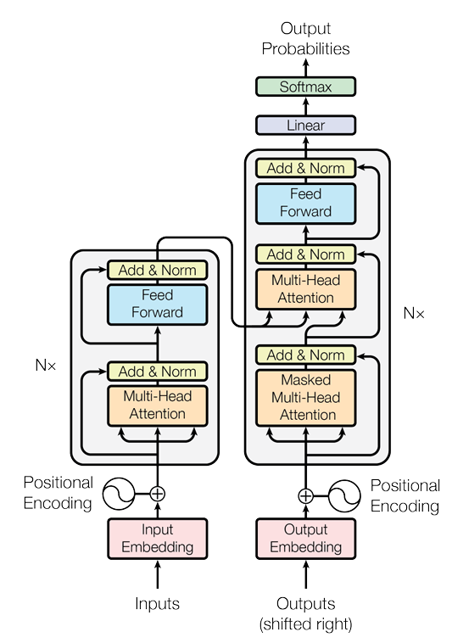
Brief Overview of LLMs
A Large Language Model is a very large deep learning model, trained on massive amounts of data, that understands and generates human-like responses to a wide range of prompts and questions.
SOURCE: https://arxiv.org/abs/1706.03762

Slide 60
Large Language Model (LLM) Taxonomy
Resource: LLM Taxonomy by Task Type

Slide 61
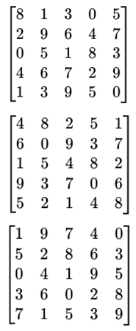
TRANSFORMER
Language Translation
Text Summarization
Text Paraphrasing
ENCODER
DECODER
Natural Language Understanding (NLU)
Text Classification
Named Entity Recognition
Textual Entailment
Coreference Resolution
Natural Language Generation (NLG)
Text Completion
Question Answering
Report Writing
Coreference Resolution
Vector Embeddings

Slide 62



Ich sehe ein Eincorn
I see a unicorn!
ENGLISH
GERMAN

Slide 63
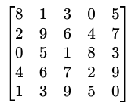
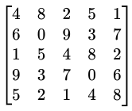
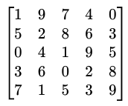
How a Transformer Works
I
Ich
see
sehe
a unicorn
ein Eincorn
A computer readable form that contains all the information of the utterance
ENGLISH
GERMAN

Slide 64
Encoder
Decoder
I
Ich
see
sehe
a unicorn
ein Eincorn
ENGLISH
GERMAN

Slide 65
TRANSFORMER
Language Translation
Text Summarization
Text Paraphrasing
ENCODER
DECODER
Natural Language Understanding (NLU)
Text Classification
Named Entity Recognition
Textual Entailment
Coreference Resolution
Natural Language Generation (NLG)
Text Completion
Question Answering
Report Writing
Coreference Resolution
Vector Embeddings

Slide 66

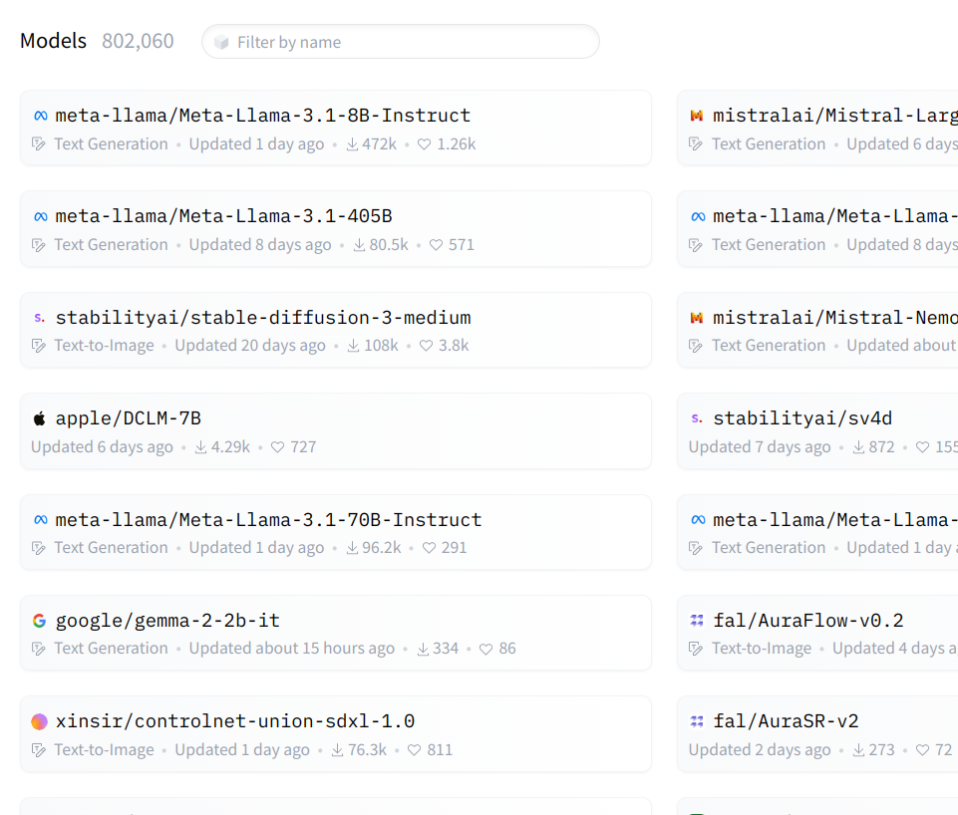
Hugging Face
Hugging Face is an open-source large language model (LLM) platform that provides pre-trained LLMs for a variety of purposes.

Slide 67

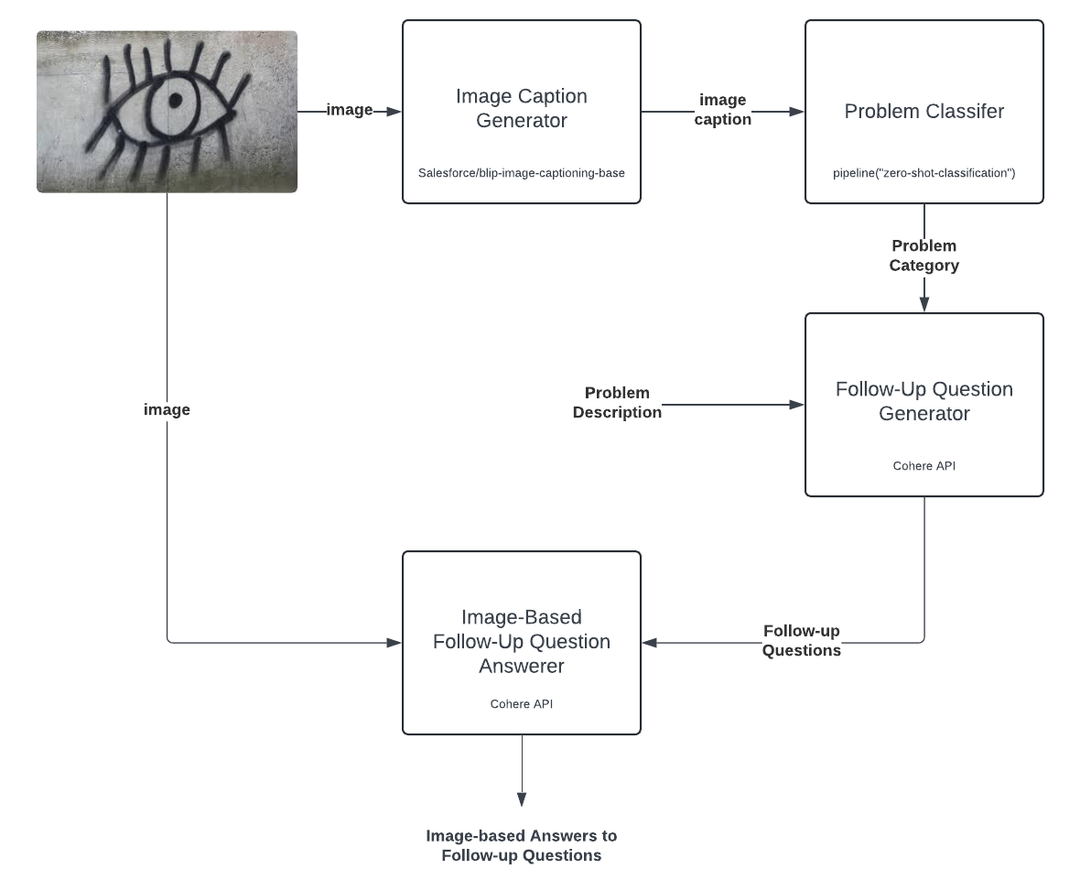
LLM Exercise
Open Generative AI Exercise.ipynb in Google Colab.
SOURCE: Image generated by Google Gemini.

Slide 68

Discussion of Needs and Next Steps
What projects are you working on?
What in the course was helpful and relevant to those projects?
What other training would be helpful?

